Slide 1

Libya
Opportunities and Risks for Defence, Security and Dual Use Exporters

Slide 2
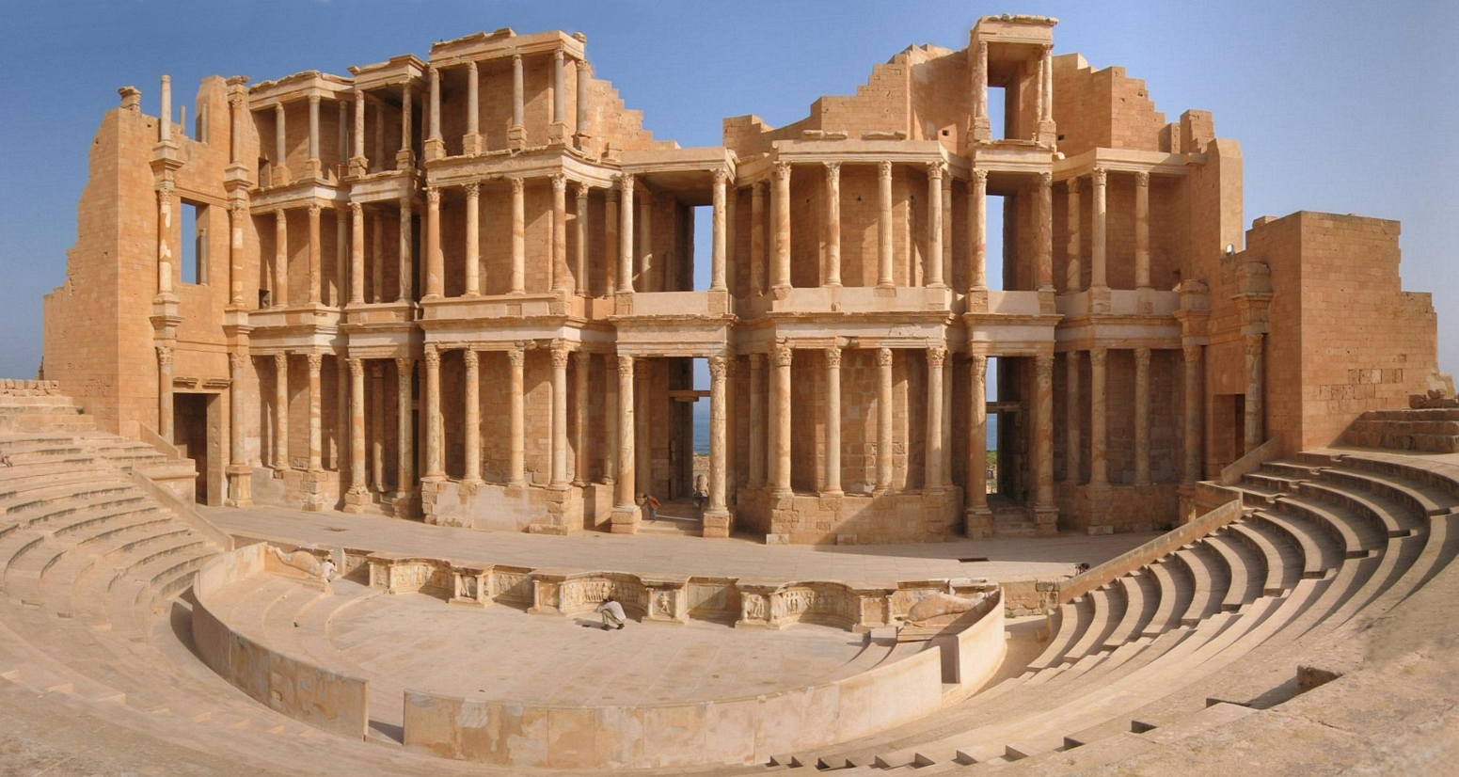
Headlines
Political Background
Economy
Doing Business
Equipment Requirements
Export Control Issues
Recent Exports
Avoiding licensing delays

Slide 3
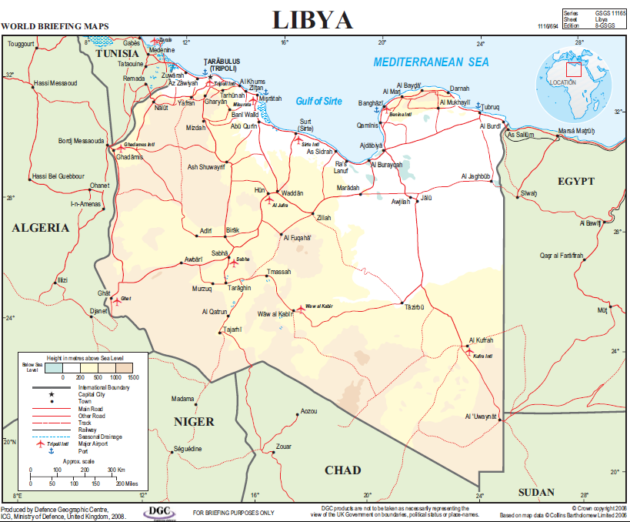
Headlines
political instability, fragile democracy, militia and tribal rivalry
transit route for African illegal immigrants to Europe
immature institutions, inexperienced officials
high levels of insecurity, large volumes of unsecured light weapons, long poorly-controlled borders
concerns over human rights, internal conflict and risk of diversion of UK exports e.g. to militias or to extremists in the wider region
strong Western political support for stability and democratic reform following the NATO intervention
UN Arms Embargo but with significant exemptions
In 2013, total value of licensed goods exported: £23.7m

Slide 4

Political Background
former Roman colony originally inhabited by Berbers and settled by Phoenicians; invasions by Vandals, Byzantines, Arabs, Turks and Italians
1951 gains independence
1959 oil discovered
1969 Gaddafi came to power in a coup
August 2011 Gaddafi overthrown following a six-month uprising and NATO air strikes to protect civilians
October 2011 the main opposition group, the National Transitional Council, declared the country officially "liberated" and pledged to turn Libya into a pluralist, democratic state

Slide 5
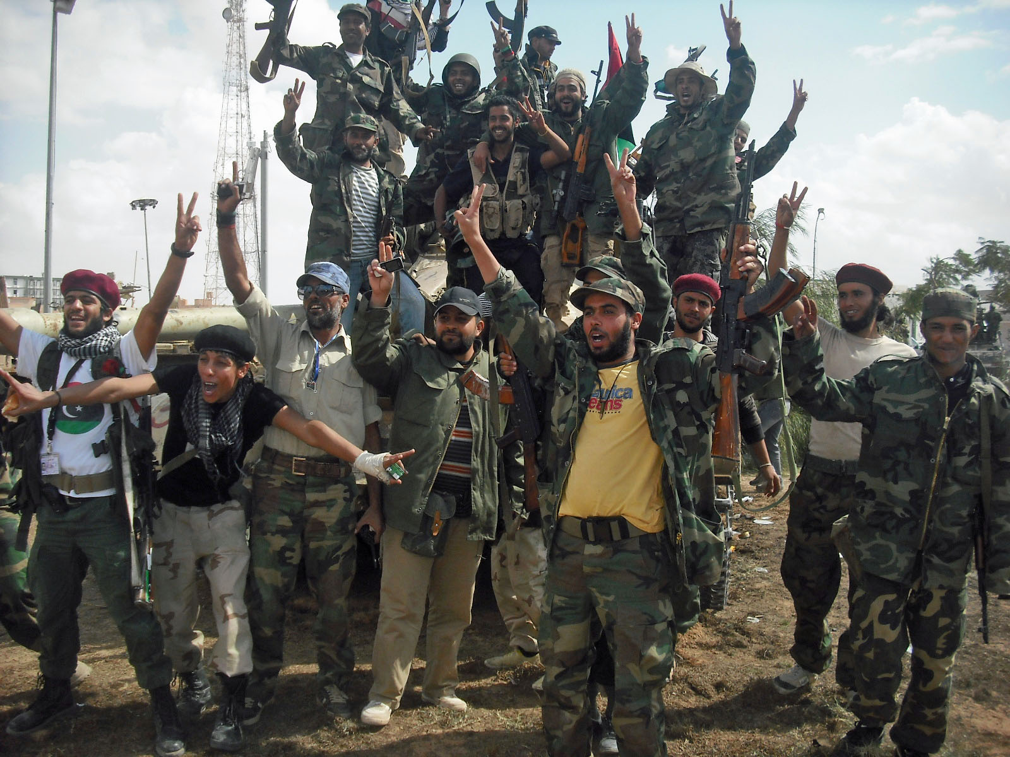
Political Background
The transitional government faces significant challenges managing the pledged transition to democracy and the rule of law
rebuilding the economy
creating functioning institutions
disbanding the plethora of armed groups - some tribal, others originating in the anti-Gaddafi rebellion, others newly-formed. Some continue to block the legitimate lifting of oil
imposing security, particularly in the East: shootings and suicide bombings continue in Benghazi
controlling borders

Slide 6
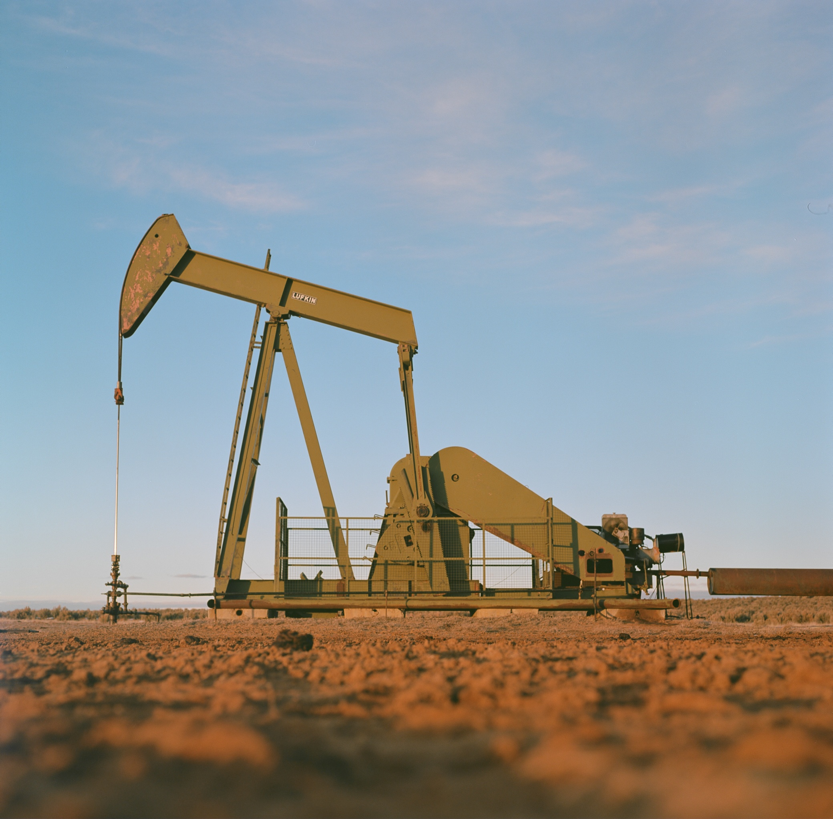
Economy
Libya holds the largest proven oil reserves, and the 3rd largest gas reserves, in Africa
Oil and gas production accounts for 70% of Libya’s GDP, 80% of government revenues and 95% of its foreign export earnings
Sovereign Wealth Fund estimated at £30-50 billion
recovery is hampered by security issues, blockading of oil shipping, closure of some oil fields and strikes
But economic fundamentals remain strong. Developmental and reconstruction needs are enormous

Slide 7
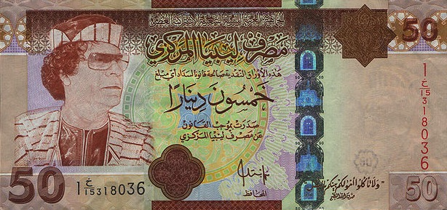
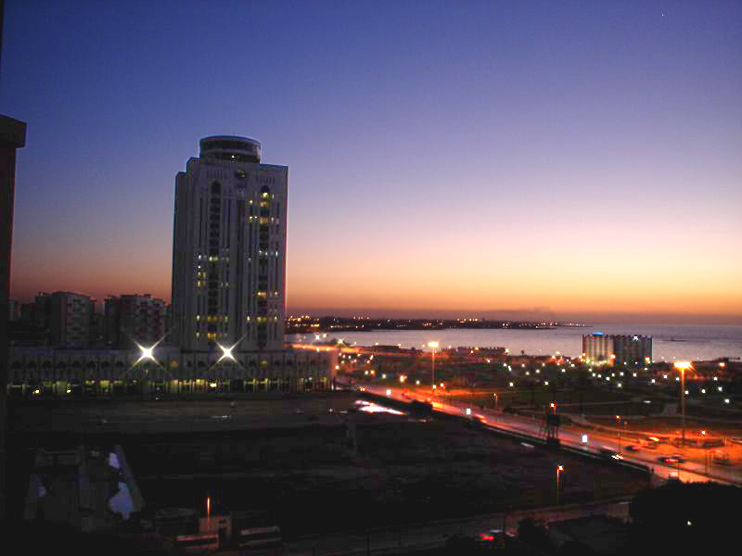
Doing Business
Although the business climate in Libya is slowly improving, obstacles remain:
bureaucracy, corruption, lack of clarity and transparency in the decision-making process, poor tax administration and the slowness of the judicial system
under-developed infrastructure and no public transport system
many companies do not have websites; few major projects properly advertised except in the oil & gas sector; only a handful of private sector Libyan corporates
increased commercial competition: all the world wants to share Libya's wealth
late payments
information, whether statistics, data about institutions, contact information or anything else, remains very hard to find.
Ministries with little experience of specification writing, tendering and procurement

Slide 8
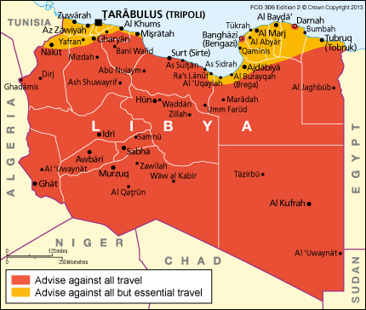
Doing Business: FCO Travel Advice
See FCO website for updates

Slide 9
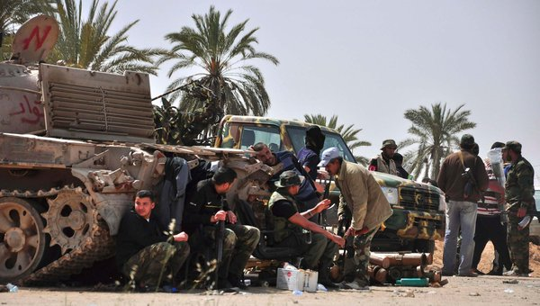
Defence & Security Requirements
Significant opportunities in short, medium and long term:
equipment and training to secure vast land, air and sea borders
re-equipping and associated training for the Air Force, Navy and Army
Ministry of the Interior and the Police require advice, equipment and assistance in all sectors and are keen to engage with the UK
English language training is a key requirement for most training packages requested by the Libyans

Slide 10
Export Control Issues
The main constraints on exporting sensitive goods to Libya are:
The UN and EU embargoes. But there are potential exemptions for most items, including lethal weapons, for both the Libyan authorities and civilian end users
If there is a clear risk that a UK export might be used for internal repression, an export licence will be refused
HMG will also look closely at the risks of an export fuelling internal tensions or being diverted to an undesirable end user, both within and outside Libya
In practice, very few applications are refused and significant quantities of goods are exported. There is scope for this to increase substantially.

Slide 11
Export Control Issues:
UN & EU Arms Embargoes
Following the conflict in 2011, Libya is still subject to:
  UN arms embargo on all Military Listed goods: covers the sale, supply, transfer of the ML equipment, as well as financial assistance, technical assistance, training or other assistance, including the provision of armed mercenary personnel, related to military equipment or to military activities.
  EU embargo on “internal repression items” that are not Military Listed (check the Council Regulation 204/2011 Annex I). Covers sale, supply or transfer of items as well as financial assistance, technical assistance, training or other assistance.
  Financial Sanctions: see HM Treasury’s list of individuals and entities – nb most of these relate to the Gaddafi regime
But there are significant exemptions: -

Slide 12

Export Control Issues:
UN & EU Arms Embargoes: Exemptions
non-lethal military equipment intended solely for humanitarian or protective use, and related technical assistance or training. No notification of the UN Sanctions Committee is required
Items temporarily exported by UN personnel, media, humanitarian and development workers for their personal use only. Protective clothing: no notification. Small arms, light weapons: notify for ‘no objection’ (Sanctions Committee approval is automatic unless a member objects within 5 days)
arms and related materiel intended solely for security or disarmament assistance to the Libyan authorities including technical assistance, training, financial and other assistance. Non-lethal: no notification. Lethal items: notify for no objection.
Other sales or supply of arms and related materiel, or provision of assistance or personnel. Requires Sanctions Committee approval
For the EU Embargo: exemptions apply to non-lethal items intended solely for humanitarian or protective use, and protective clothing temporarily exported by UN, EU, media and humanitarian and development workers and associated personnel for their personal use only. No notification required.

Slide 13
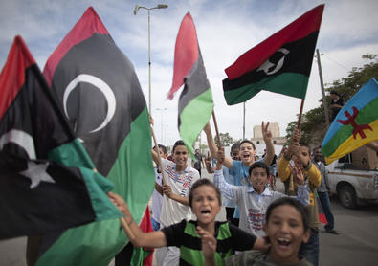
Export Control Issues:
Human Rights
HMG has to judge whether there is a clear risk that a UK export might be used for internal repression
The Libyan authorities have made repeated public commitments to human rights. But they lack capacity to deliver
structures of the army and police are weak: lack robust command and control structure, and training in human rights or international humanitarian law. However, little evidence to date of systematic abuse
the presence of assimilated and unassimilated militias under partial or minimal Government control
Detention facilities: compelling UN and Amnesty evidence of torture and ill-treatment, and arbitrary arrest and detentions of migrants, human rights activists and former Gaddafi loyalists

Slide 14
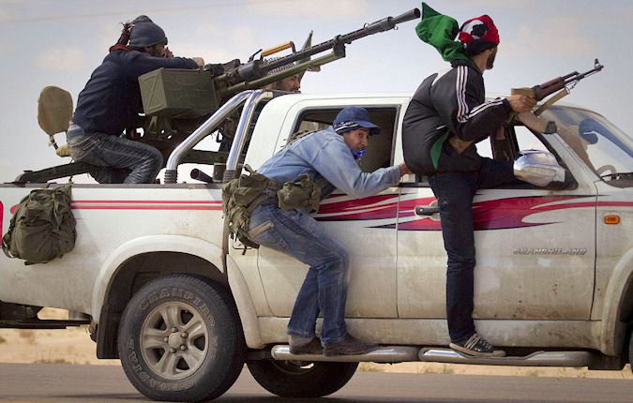
Export Control Issues:
Human Rights: Mitigations
Some reassurance may be provided by the technical specifications of equipment to be exported, particularly if it suggests that it is most likely to be used only by groups under central government control, and the absence of any reports of its being used in violations to date
goods under the control of the Prime Minister’s Office are unlikely to be misused. Its staff are some of the best trained/aware with regards to human rights.
The UK has several human rights projects (including relevant training) in its package of support to the Libyan Government.

Slide 15
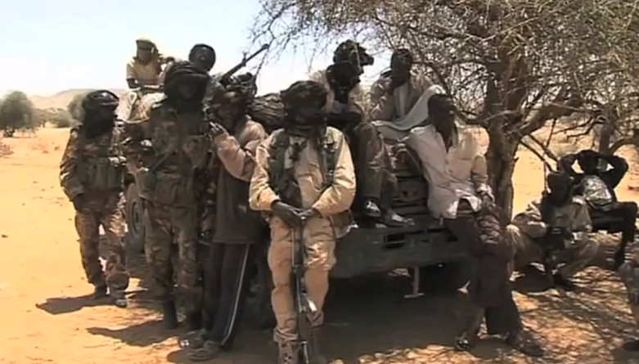
Export Control Issues:
Internal Tensions
HMG has to judge whether an export might exacerbate internal conflict and be used by some groups against others
Unlikely to do so if proposed exports will be under the control of the central government. Such equipment should increase the ability of the military and police to exert control over hostile militias and borders, and therefore exacerbation of internal conflict through this equipment would be unlikely

Slide 16

Export Control Issues:
Diversion
HMG has to judge the risk of a UK export being diverted to an undesirable end user
there is a risk of diversion to militias, through theft or intentional release, corrupt police/army personnel, capture of equipment by un-assimilated militias, or distribution of goods from the MoI/MoD to poorly controlled assimilated militias
recent attacks in Mali and Algeria have highlighted the Libyan authorities’ lack of capacity and capability; they do not have control of their borders and many of the weapons used by militants in Mali were sourced in Libya.
But in general the Libyan police and army have a strong record in retaining equipment provided to them.

Slide 17
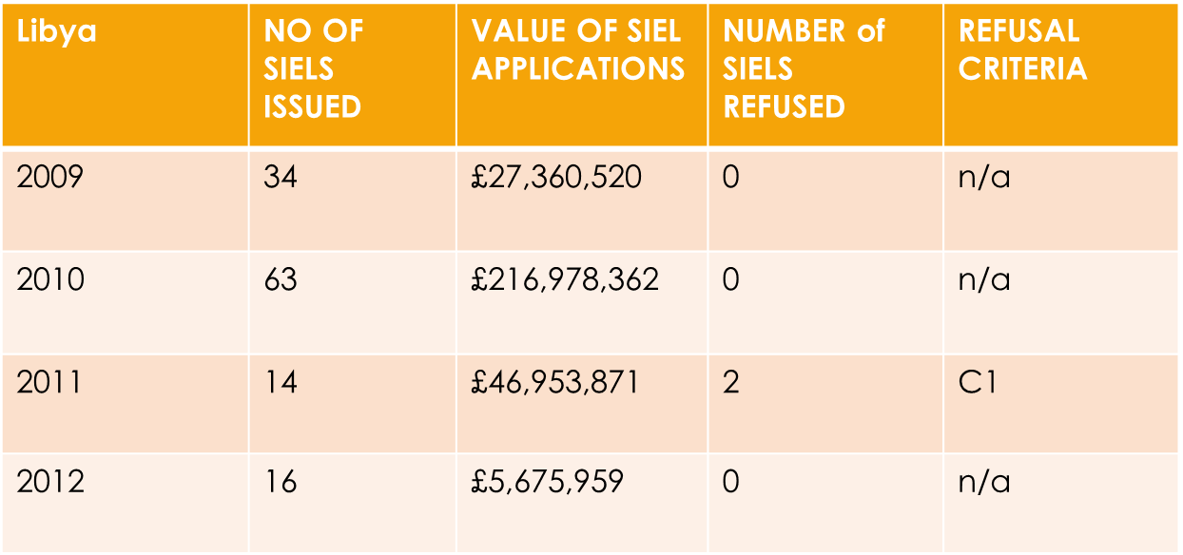
Recent Exports
Numbers and value of Standard Individual Export Licences issued for Libya
2013 57 £27.3m 4 n/a

Slide 18
Recent Exports:
Licences Approved in 2013
Equipment for initiating explosives
Bomb suits
Munitions detection/disposal eqmt
Military communications equipment
Eqmt employing cryptography
Assault rifles, Pistols, hand grenades
Small arms ammunition
AWD vehicles with ballistic protection
UAVs
Pyrotechnic ammunition
Military thermal imaging eqmt
NBC detection eqmt
Military field generators
Laser weapon systems
Combat shotguns
Military support vehicles
IED jamming eqmt
Command & Control/comms eqmt
Civil NBC protection eqmt and clothing

Slide 19
Recent Exports:
Licences Refused in 2013
Equipment for armed groups outside direct central government control
Body armour, military helmets
IMSI grabbers, radio surveillance equipment
Some UAVs for some end-users
Military image intensifiers
Demonstration equipment to Benghazi
Imaging cameras – under Embargo

Slide 20
How to avoid export licensing delays
Bear in mind that HMG may need to get confirmation from the Libyan government and approval from the Sanctions Committee before issuing an export licence. Delays can be avoided by providing full information with the original application, including:
detailed information on the equipment specifications
for Government end users – the specific unit acquiring the equipment and an End user Undertaking signed by head of MOD/MOI
for civilian end users - website details
For all end users - what exactly do they require the equipment for? Are they receiving any international training?

Slide 21
Richard Tauwhare
Green Light Exports Consulting
Email: richard@greenlightexports.co.uk
Web: www.greenlightexports.co.uk
Phone: +44(0)770 311 0880

